Slide 1
I See Metrics: Anomaly Detection on OpenShift
AI Ops in the AI Center of Excellence
DevConf.CZ 2020
Hema Veeradhi (Software Engineer)
Anand Sanmukhani (Software Engineer)
Michael Clifford (Senior Data Scientist)

Slide 2
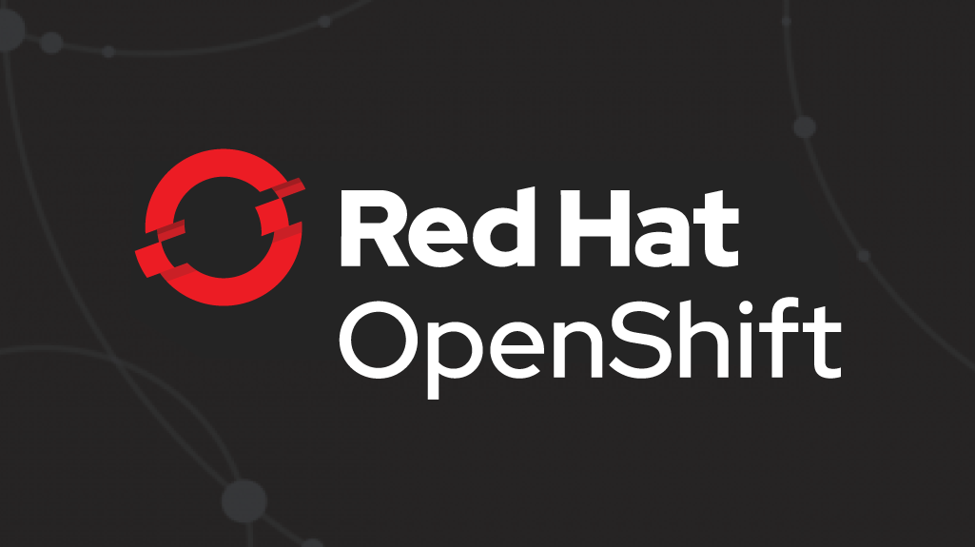


AI-backed anomaly detection for prometheus metrics.
Monitoring
Applications
Prometheus
Notes:
As IT operations become more agile and complex, at the same time the need to enhance operational efficiency and intelligence grows. Monitoring applications and kubernetes clusters with Prometheus has become quite common. Yet, identifying relevant metrics and thresholds for your setup is getting harder.

Slide 3
Goals of Workshop
Understanding Prometheus
Monitoring applications and its challenges
Leveraging AI for better monitoring
Data Science toolkit
Anatomy of an anomaly
Integrating anomaly detection pipeline into monitoring setup

Slide 4
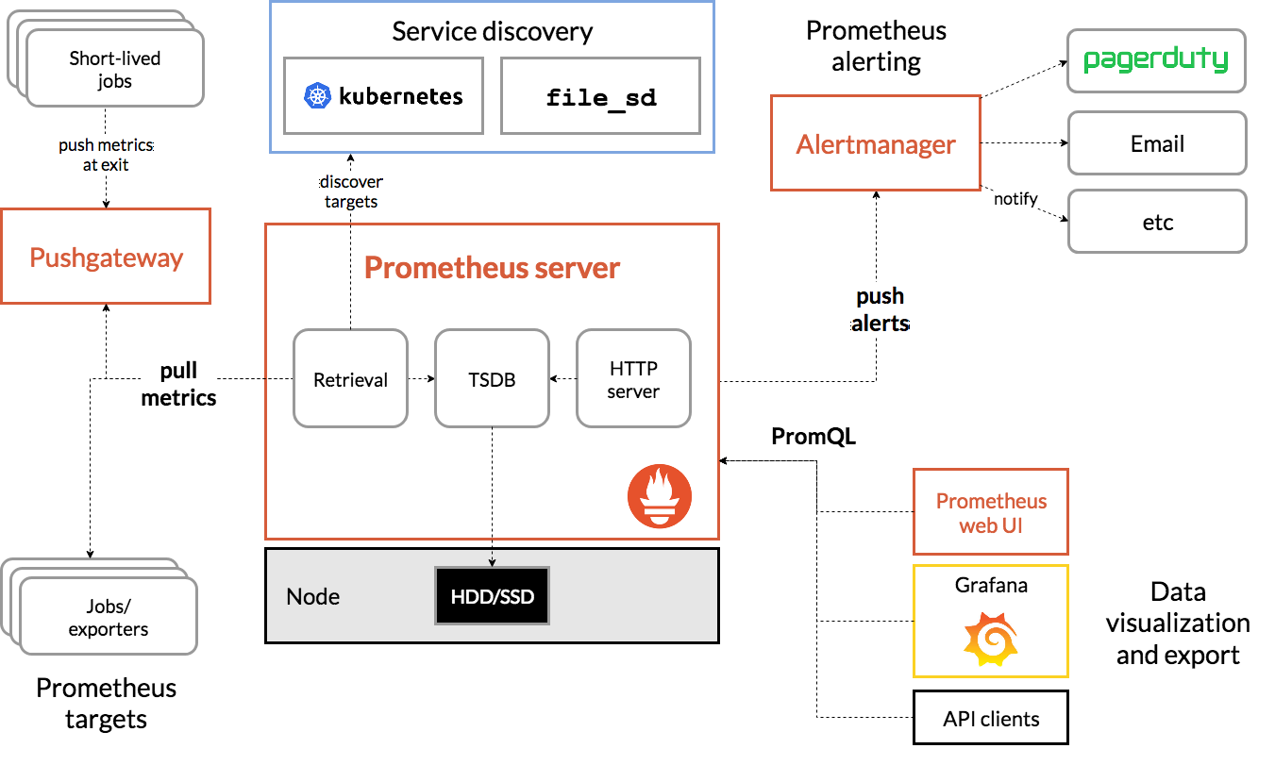
Prometheus
AI Ops
Notes:
Prometheus is an open-source system monitoring and alerting toolkit, it provides time series data with various metrics to analyze the performance of our servers and clusters. Prometheus scrapes metrics from instrumented jobs, either directly or via an intermediary push gateway for short-lived jobs. It stores all scraped samples locally and runs rules over this data to either aggregate and record new time series from existing data or generate alerts

Slide 5
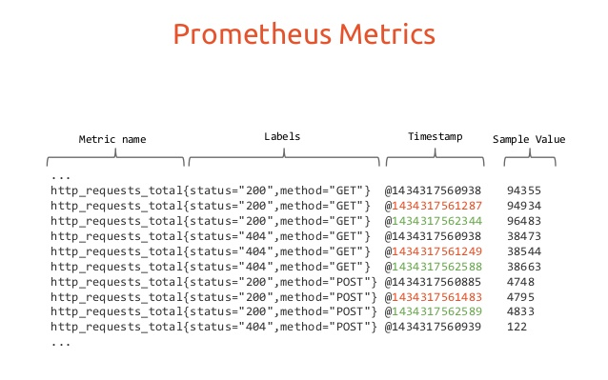
AI Ops
Gauge - Arbitrary up and down value
Counter - Monotonically Increasing
Histogram - Cumulative samples of values
Summary - Snapshot of values in a time window
Notes:
With the increased amount of metrics flowing in it is getting harder to see the signals within the noise. Our application leverages machine learning algorithms such as Fourier and Prophet models to perform time series forecasting and predict anomalous behavior in the metrics. (Eg: CPU usage)

Slide 6
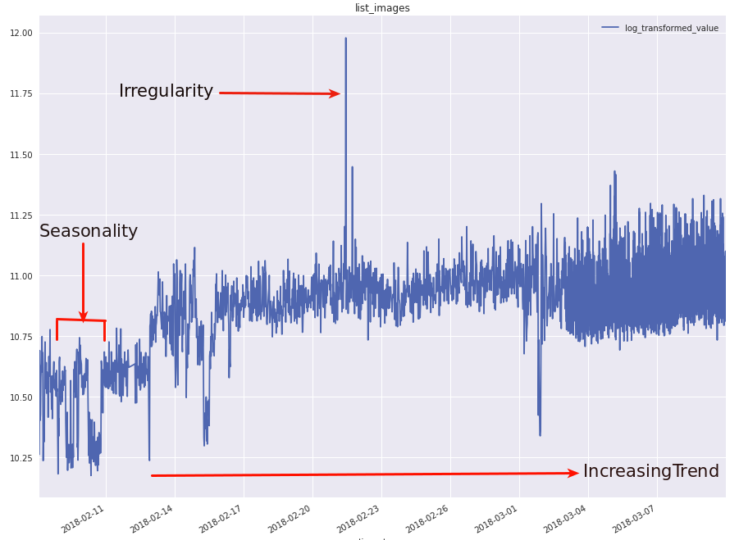
Components of Time Series
Trend
Increase or decrease in the series over a period of time.
Seasonality
Regular pattern of up and down fluctuations. It is a short-term variation occurring due to seasonal factors.

Slide 7
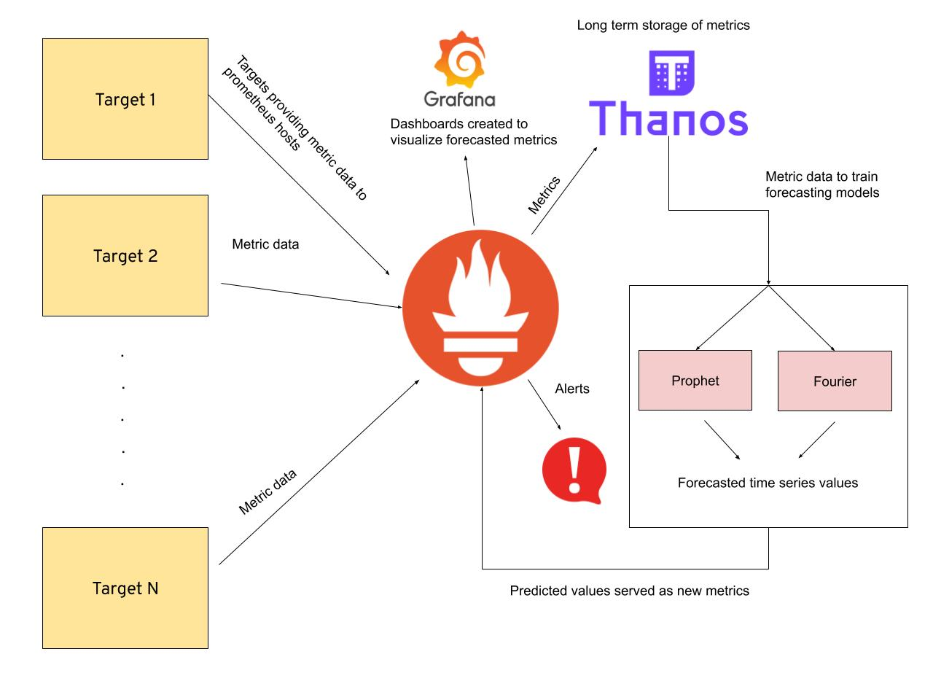
Implementation
AI Ops
Notes:
Data - Prometheus metrics scraped from specified hosts/targets
Models being trained -
Fourier - It is used to map signals from the time domain to the frequency domain. It represents periodic time series data as a sum of sinusoidal components (sine and cosine)
Prophet[https://facebook.github.io/prophet/] - Procedure developed by Facebook for forecasting time series data based on an additive model where non-linear trends are fit with yearly, weekly, and daily seasonality, plus holiday effects. It works best with time series that have strong seasonal effects and several seasons of historical data. The following are the forecasted values:
yhat - Predicted time series value
yhat_lower - Lower bound of uncertainity interval
yhat_upper - Upper bound of uncertainity interval
Visualization - Grafana dashboards are created to visualize the predicted metrics
Alerts - Prometheus alerts are configured based on predicted metric values. Alerts triggered via gchat/email.

Slide 8
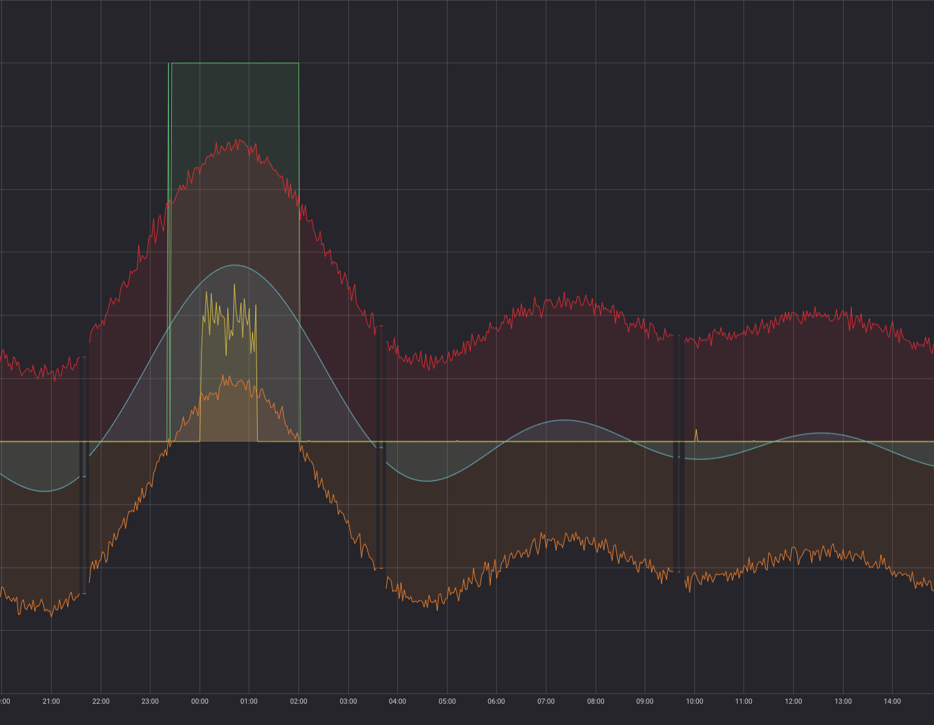
AI Ops
Grafana Dashboard Visualization
Anomaly
Predicted value
yhat_upper
Actual metric value
yhat_lower

Slide 9
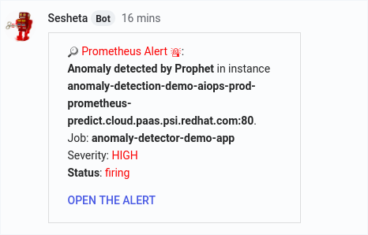
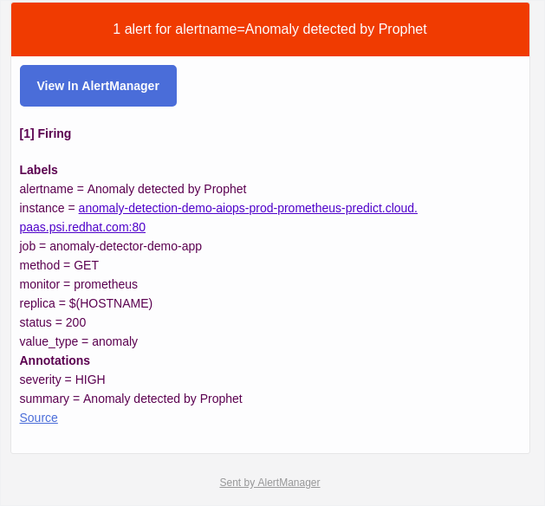
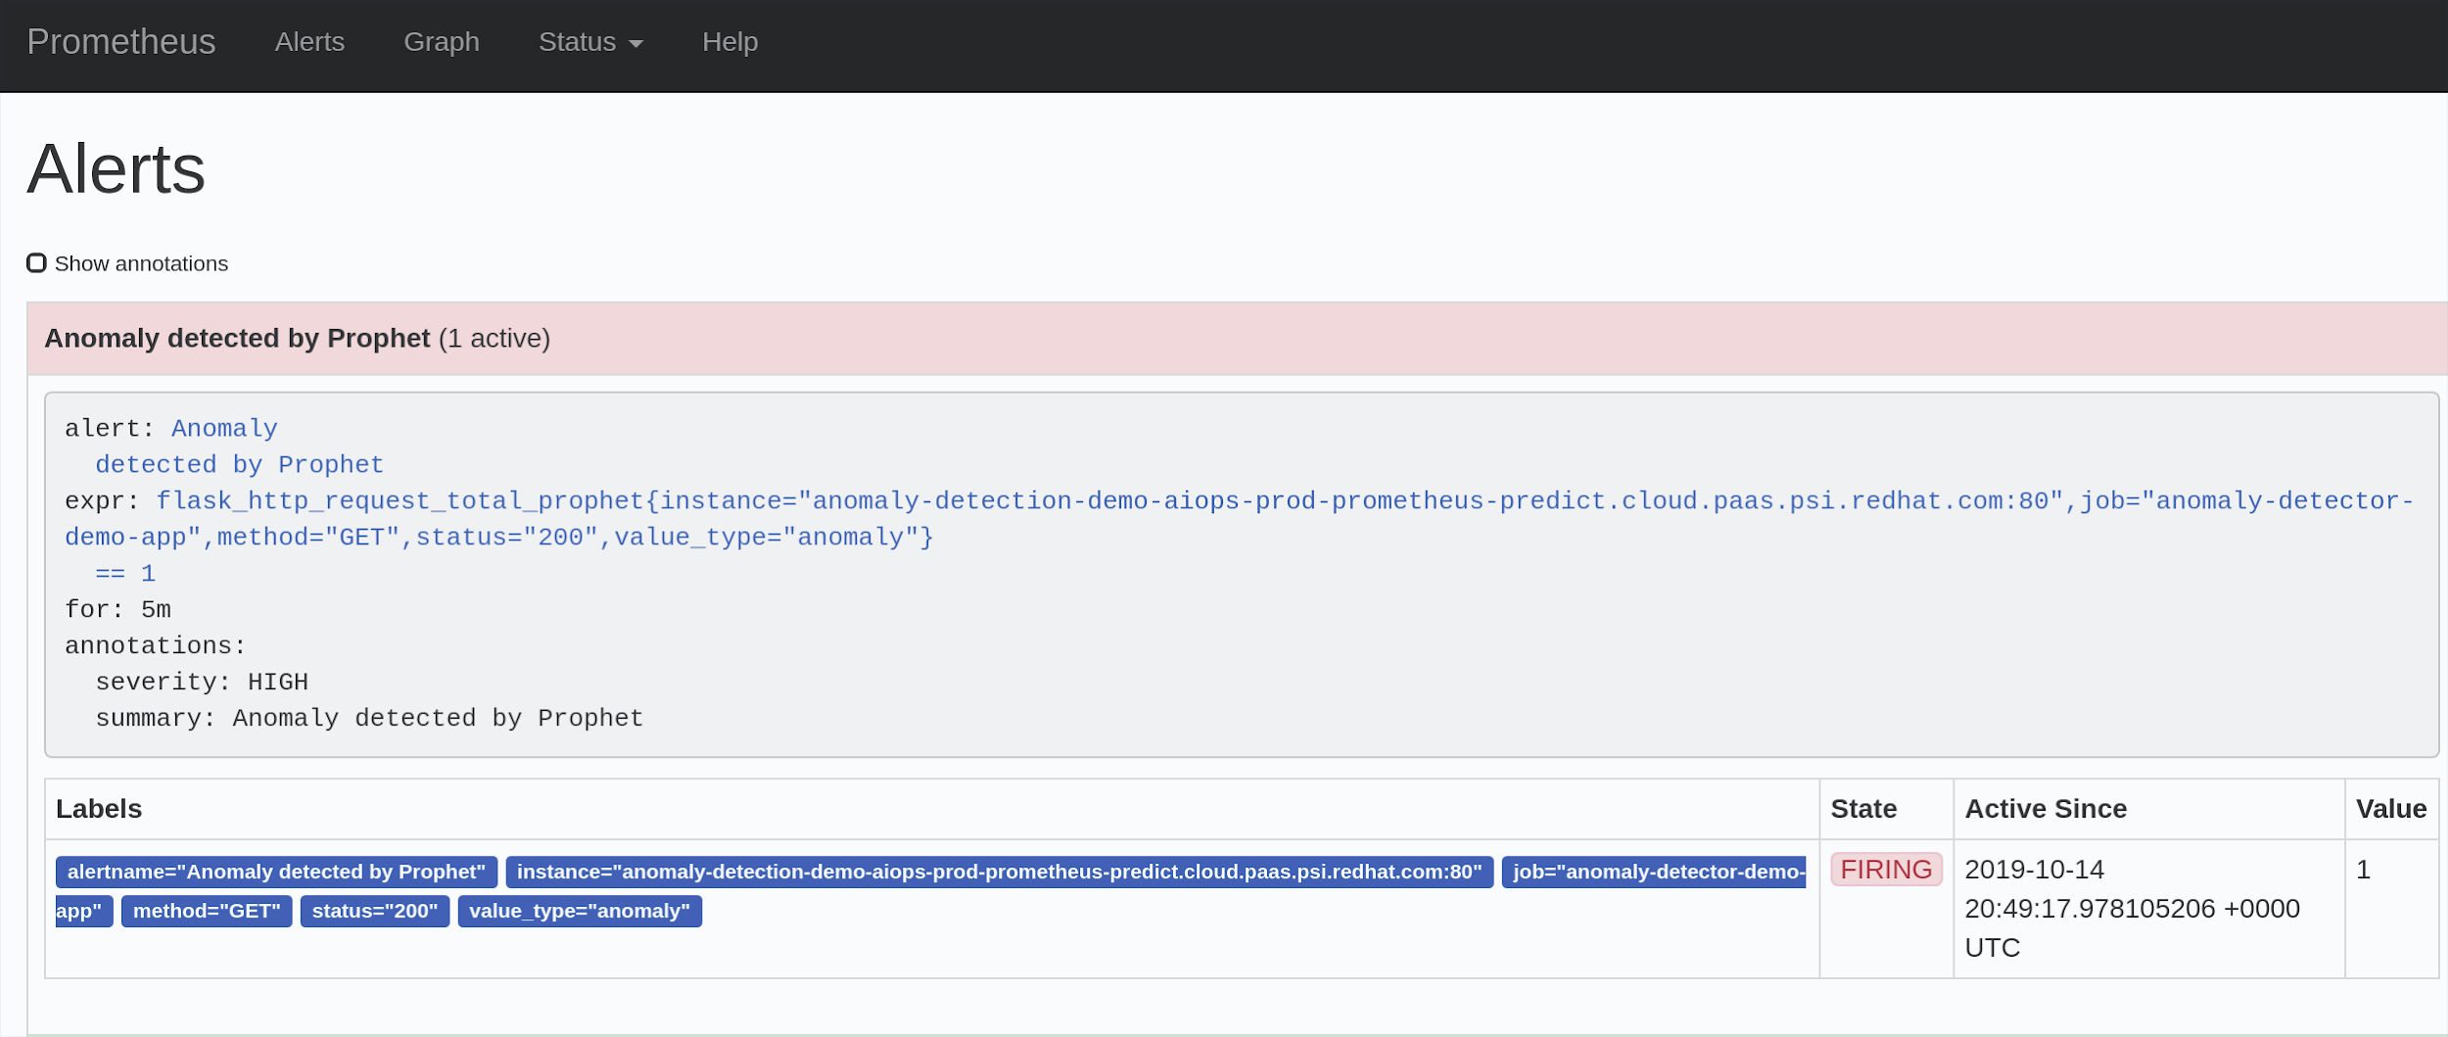
AI Ops
Alerting on Anomalies
Notes:
The alerts are configured to send automated messages through a chatbot via Google chats and email, notifying the respective teams. The google chat alerting architecture is maintained in two parts:
The predicted metrics are scraped by Prometheus
We configure the prometheus alertmanager to send a webhook trigger to the team Thoth’s bot, Sesheta which is configured to trigger alert notifications in google chat
The alerts are configured through alerting rules (specified in a yaml file) which allow you to define alert conditions based on Prometheus expression language expressions and to send notifications about firing alerts to an external service. Whenever the alert expression results in one or more vector elements at a given point in time, the alert counts as active for these elements' label sets.

Slide 10
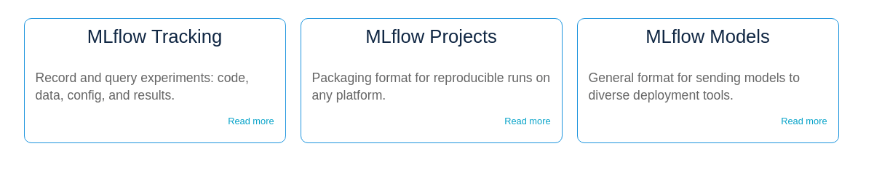
Model Testing
AI Ops
For a given timeframe of a metric, with known anomalies, the PAD can also be run in test-mode to check whether the models reported back these anomalies. The accuracy and performance of the models can then be logged as metrics to MLFlow for comparing the results.
MLFlow: https://mlflow.org/
Notes:
MLflow is an open source platform to manage the ML lifecycle, including experimentation, reproducibility and deployment. It currently offers three components:
MLflow Tracking - Tracking server used to record experiment runs
MLflow projects - Package format for reproducible runs
MLflow models - Sending models to other deployment tools

Slide 11
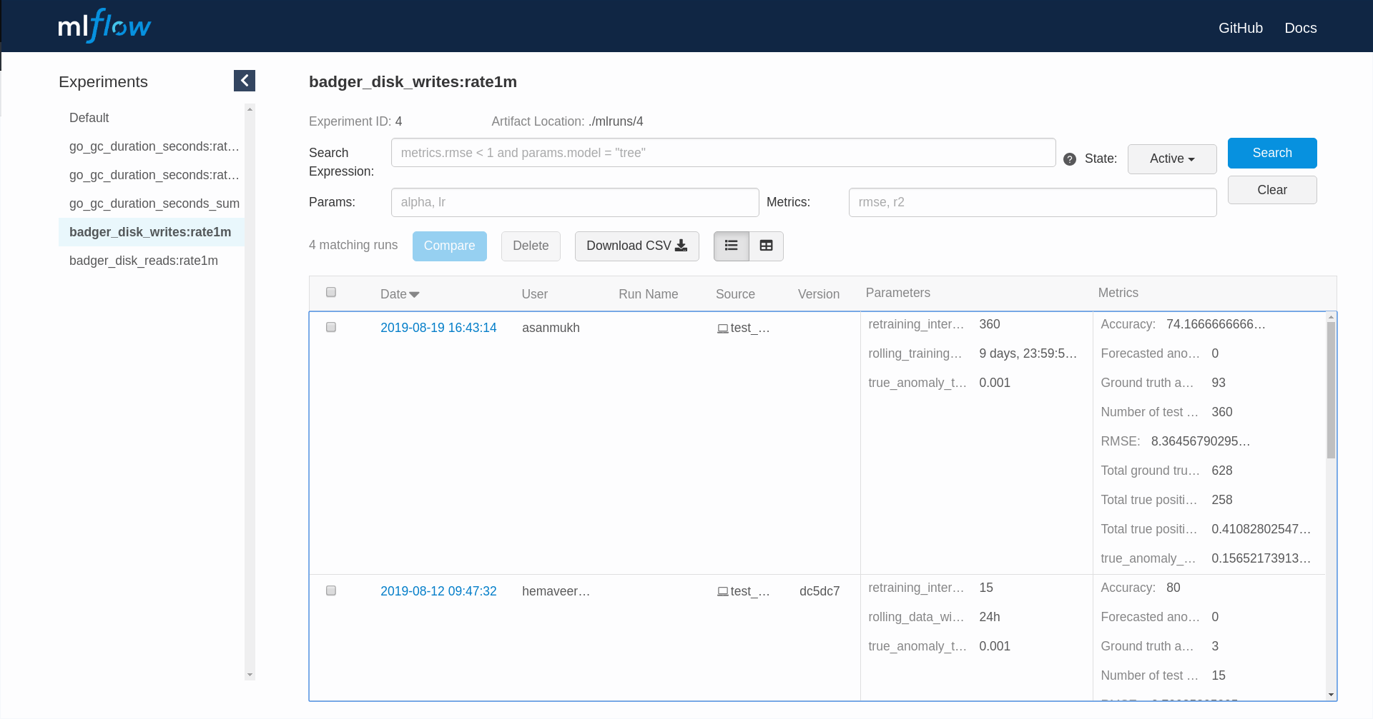
AI Ops
Notes:
The MLflow Tracking component is an API and UI for logging parameters, code versions, metrics, and output files when running your machine learning code and for later visualizing the results. MLflow Tracking lets you log and query experiments using Python, REST, R API, and Java API APIs. Each execution of a data science model/code is termed as a ‘run’. You can organize runs of a particular model into a single experiment.

Slide 12
References
AI Ops
Project Repository: https://github.com/AICoE/prometheus-anomaly-detector
Prometheus API Client: https://github.com/AICoE/prometheus-api-client-python
Mojo blog post: https://mojo.redhat.com/groups/red-hat-artificial-intelligence-center-of-excellence-ai-coe/blog/2019/09/10/prometheus-anomaly-detection-for-thoth-dgraph-metrics
Team Mail list: aicoe-aiops@redhat.com
GChat: AICoE - AIOps

Slide 13
Thank you
Red Hat is the world’s leading provider of enterprise open source software solutions. Award-winning support, training, and consulting services make Red Hat a trusted adviser to the Fortune 500.

